Slide 1
Book
" The stars only shine at night... "
C.I.D. World Congress – ATHENS - 6/10 July 2022

Slide 2
Introduction
Gisèle Hélène LAMIELLE, French
Founder & President of " Les infantes de Noverre"
Teatcher
Classic dancer ( Roberto Bestonso Company, Paris )
Choregrapher

Slide 3
Book presentation
" The stars only shine at night... "
A Testimony
A human adventure
Working under the aegis of charity
My passion for classical dance & my work of adaptation

Slide 4
" My book reply to 3 questions "
Why did I create this method ?
Why did I name my school " Les Infantes de Noverre " ?
What encounters and events have changed my life to get to this point ?

Slide 5
" Public concerned "
People with disabilities.
Children.

Slide 6
" The love of writing"
A first book regrouping the beginning of my strange work
A Memoir.
This Book " Les étoiles ne brillent que la nuit "
Many professionals have written about disability

Slide 7
The advantages…
To talk about my Infantes de Noverre.
Naming, describing, encouraging, sublimating them…

Slide 8
" The access of the culture "
A fundamental right.
But Art and any other cultural activity often therapeutic for them.
Discipline, method, choreography... All this can be adapted to each of us.

Slide 9
" Entering in my dance "
Free ourselves from our preconceived notions.
If I was handicapped, how would I live this ignominy ?
Authencity.
Dance is able to metamorphose.
A Master degree student testimony

Slide 10
" Dance, a tool"
Persons with intellectually challenged, PDD or others.
https://drive.google.com/file/d/1NlmftlFU_OVd14nP09AJQjGngMW6V2FB/view

Slide 11
" Why does man so hierarchically classify bodies ? "
Dance always has its limits.
Dance takes people out of a certain image that locks them in .
The memory of a Tango evening.

Slide 12
" Dance is not only a therapy"
A source of wonder.
The relationship

Slide 13
" The children "
Able-bodied
Fragile
In a situation of handicap, motor, cerebral, mental, dys, hearing impaired

Slide 14
" Once a Speaker, always a Speaker "
A new technique of classical dance.
People with motor and cerebral disabilities.
Mixed modules.
A concept that encompasses all the cultural facets of this art testimony.
Without the fear.
We must rethink the handicap.

Slide 15
" The author of such a method "
The body is a real tool.
Without exclusion.
The dance is liberating.
Would the dream be reserved for a category of individuals ?
The adaptation of classical dance to all therefore requires the development of a true technique.

Slide 16
" Dance for all, Maison de la Danse 2014"
Inclusion.

Slide 17
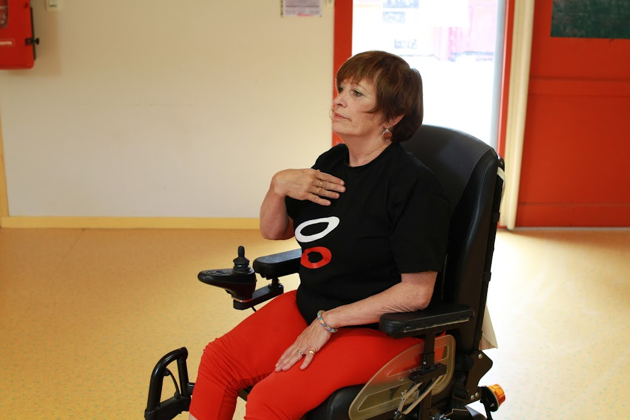
" Dance for all, Maison de la Danse 2014"
Chantal Requena, former prima ballerina of the Lyon Opera who is now in a weelchair

Slide 18
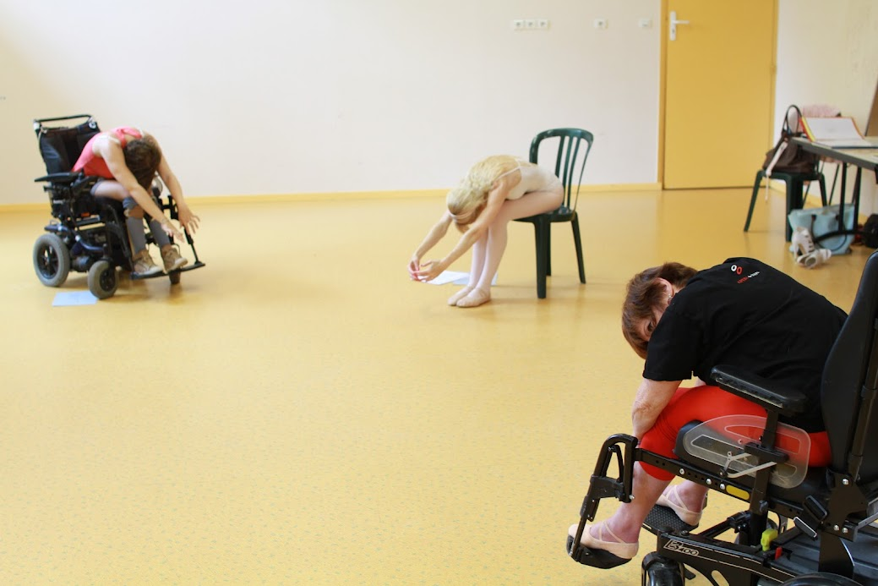
" Dance for all, Maison de la Danse 2014"
Chantal Requena, Elaine Decoeur, Gisèle Hélène Lamielle

Slide 19
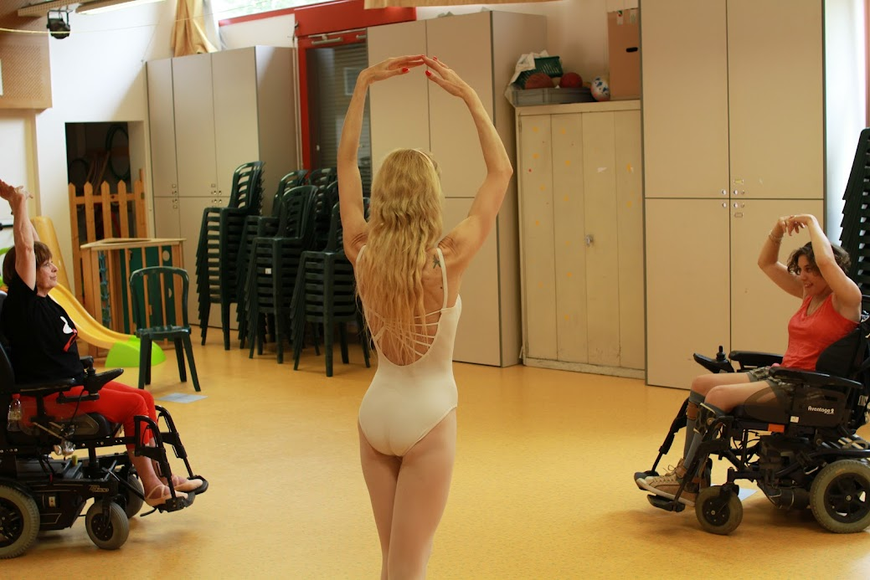
" Dance for all, Maison de la Danse 2014"
Chantal Requena, Elaine Decoeur, Gisèle Hélène Lamielle

Slide 20
" 2016, Ballet Conference
Les Infantes de Noverre"
"2015" in homage to the victims of the attacks perpetrated in PARIS..

Slide 21
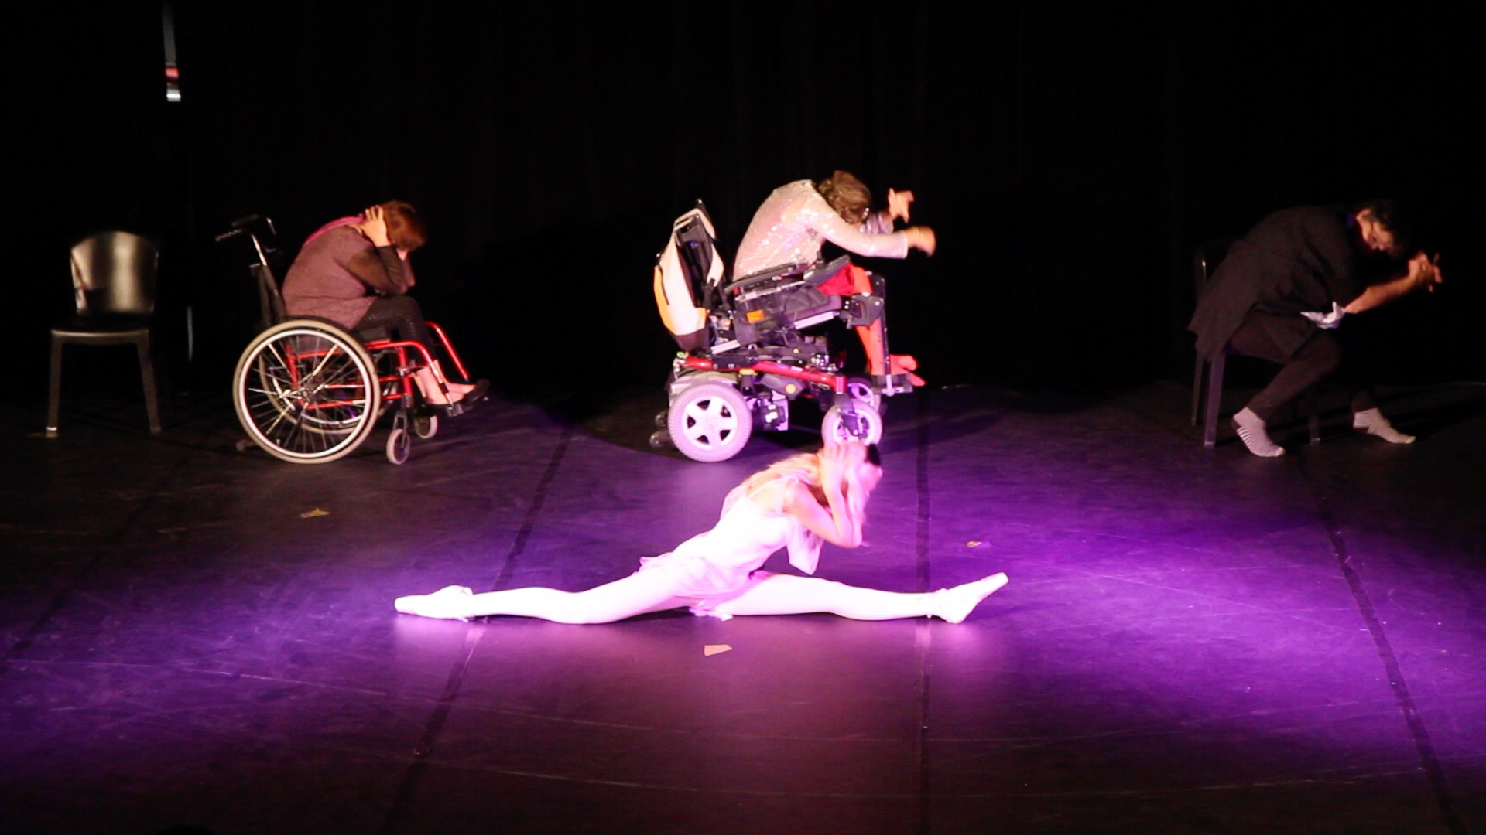
" 2016, Ballet Conference
Les Infantes de Noverre"

Slide 22
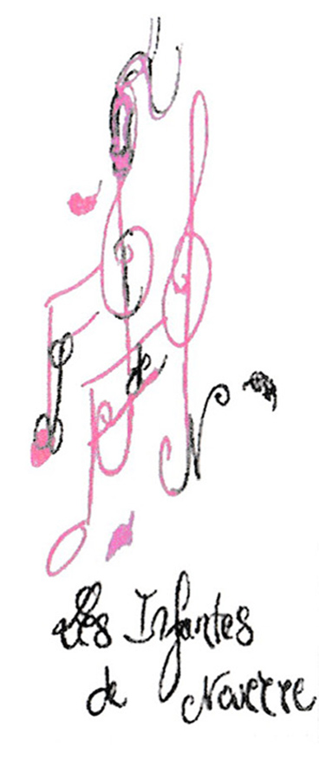
" Why this name, Why this title ? "
Why Les Infantes de Noverre ?.

Slide 23

" Why this name, Why this title ? "
Why Les Infantes de Noverre ?.
Why Star only shine at night ?.
Two paradox.

Slide 24
" Some of my ballets"

Slide 25
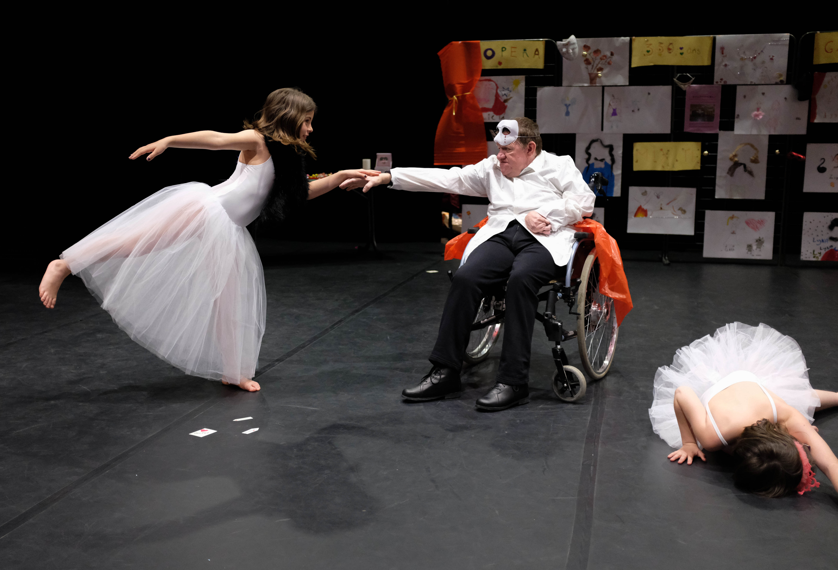
Balletissima

Slide 26
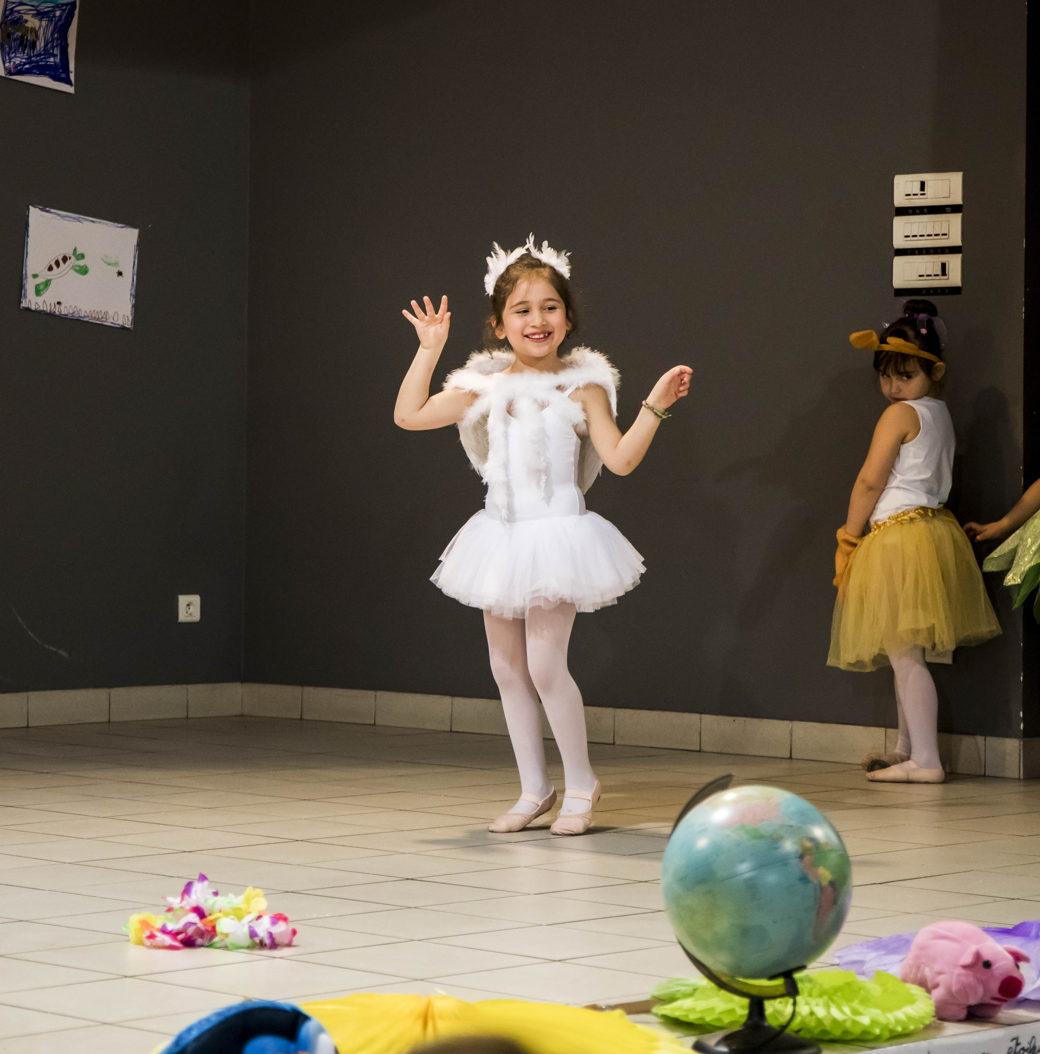
Errare Humanum est… In quo ?

Slide 27
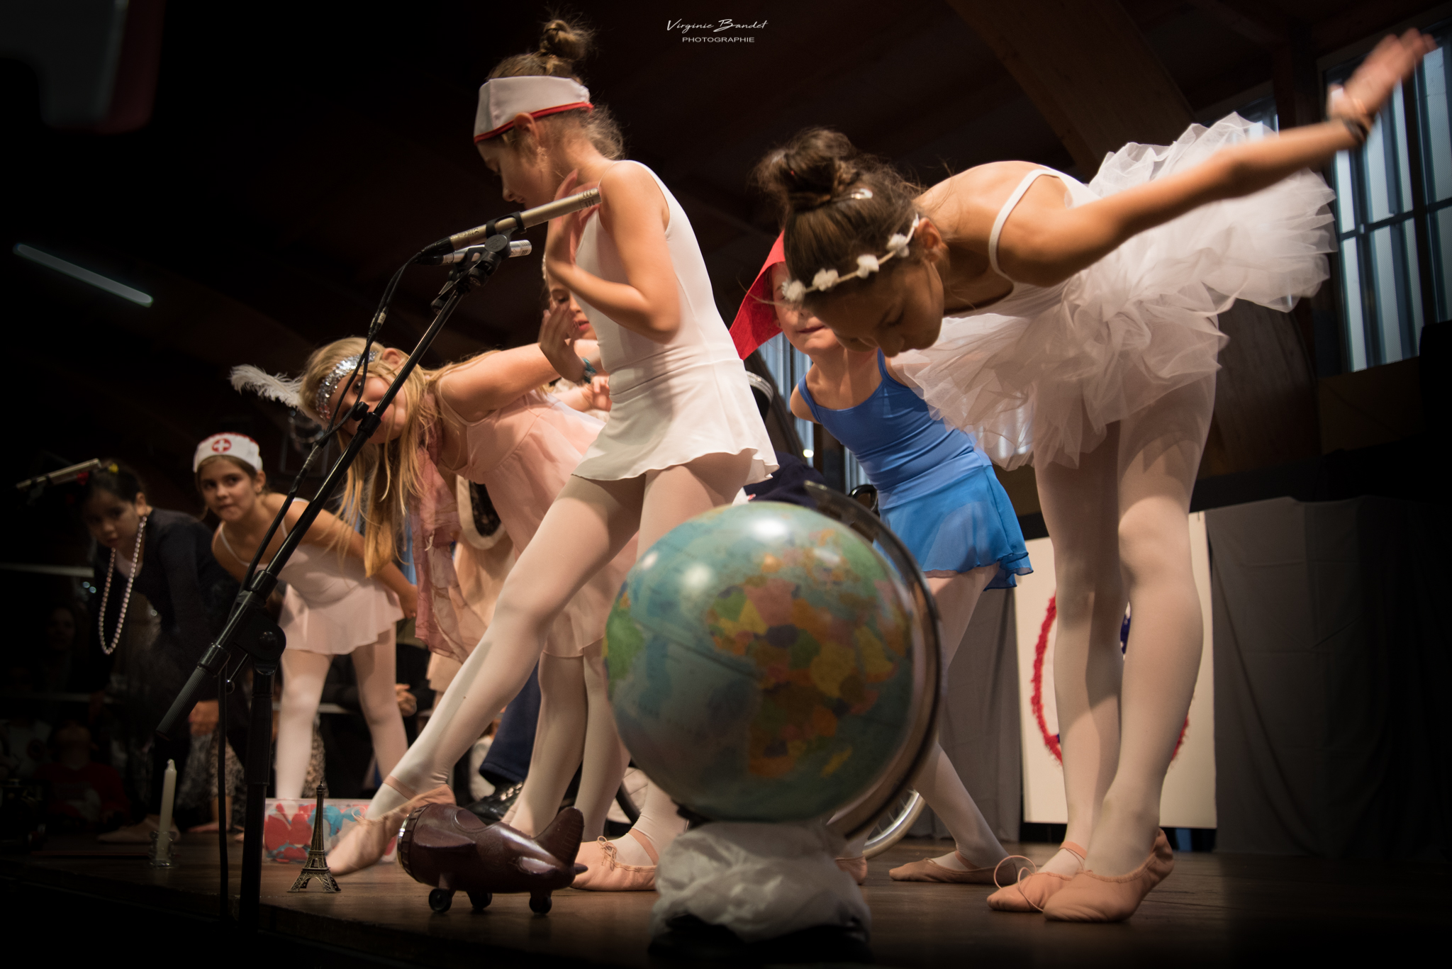
Liberté

Slide 28
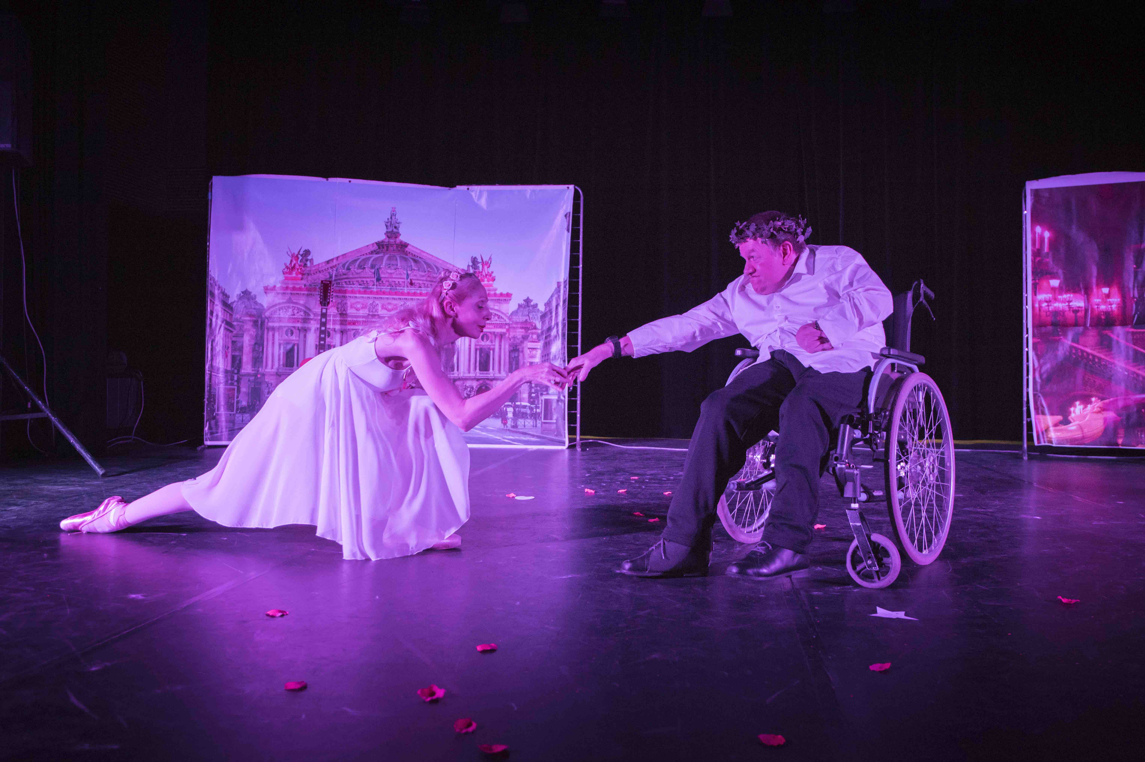
Amoroso

Slide 29
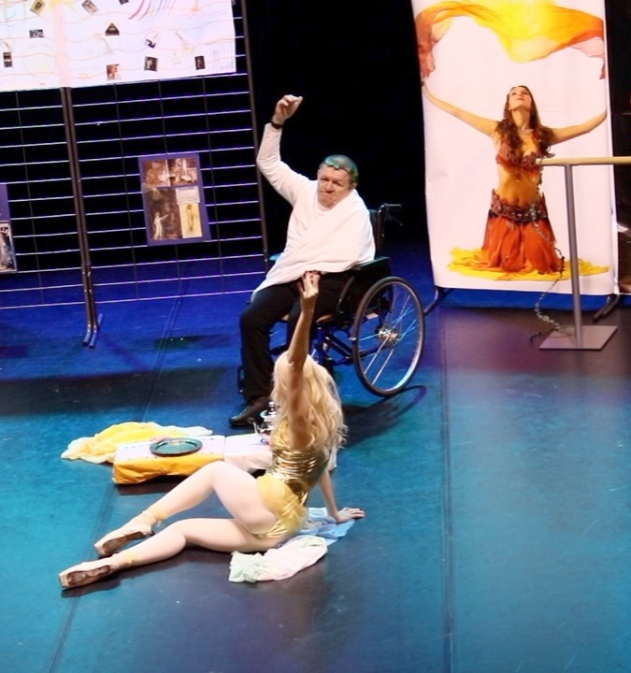
Salomé's dance

Slide 30
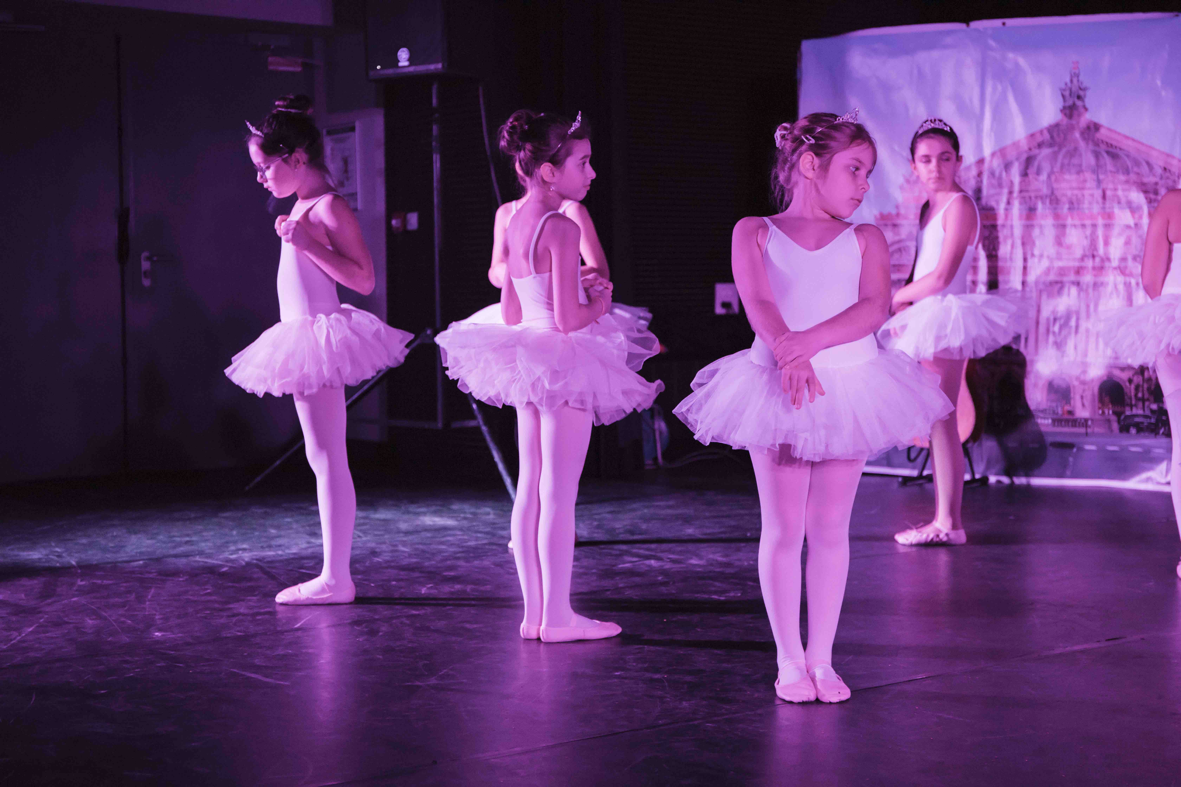
Solfège

Slide 31
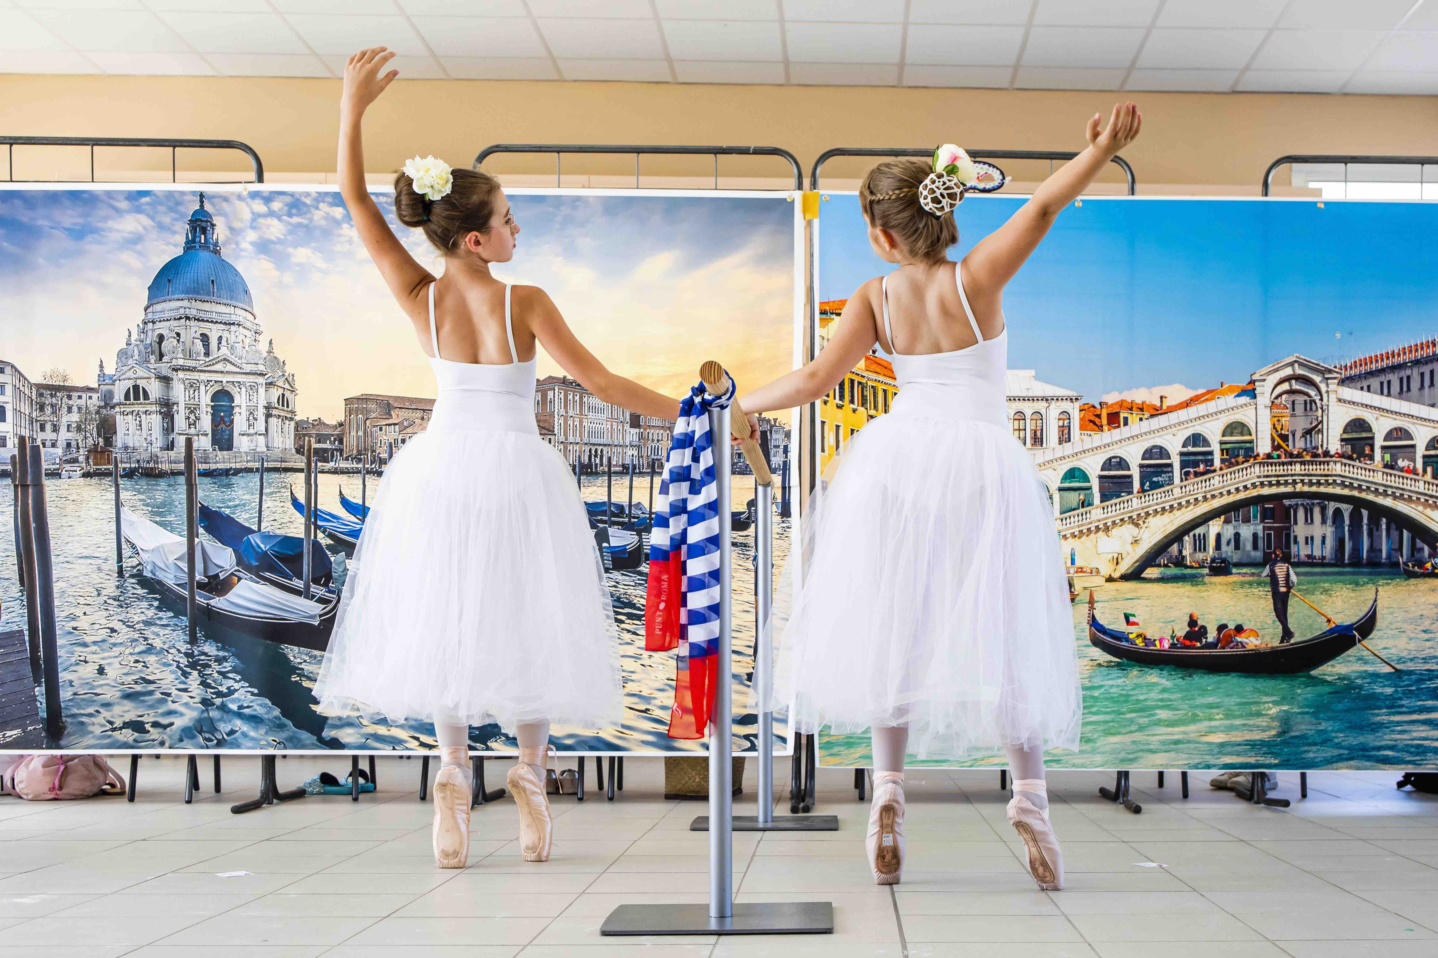
Scarpe de punta

Slide 32
" The Epilogue "
The love story between Grece and me.
Writing is an extraordinary act .
Classical Dance remains the heroine of this book.

Slide 33
Thank you very much for your kind attention
Babaï ! ( well done in classic Greek )

